Slide 1
GrowthJr
Grow your business online

Slide 2
Philosophy
Create and grow your business today
We help businesses to grow their online presence by innovative methods and reach out.
Digital Presence is no more a luxury but it’s necessity in current scenario.
Having an experience team which understands every aspect of digital presence gives us upper hand over others. We not only prepare strategy but execute them as well to make our client’s business grow.

Slide 3
Our work & achievements

Slide 4
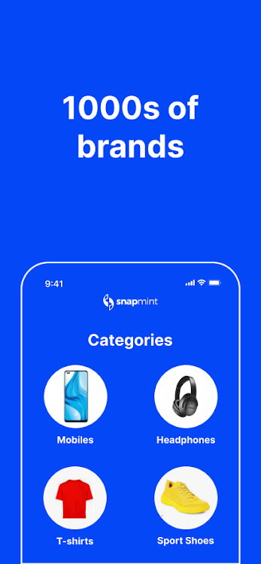
Snapmint
Objective: Scale with low CAC
Snapmint is a financial app, providing easy EMI shopping on big ecom websites
Though they have big names under their umbrella but still scale wasn’t that great
We had a look at their structure & started working on correcting measurement, campaign structure & results optimization
After a month app installs inc by 3x & sign ups have gone up by 240%. Since revenue is long cycle for them but we already beaten last few months in terms of net revenue garnered in Oct month.

Slide 5
Creditsathi
Objective: Inc leads at low cost
Creditsathi partnered with leading credit card banks to provide low limit CCs.
They were generating 1000+ leads/day with decent cost but they wanted to know if this is the optimum level.
We had a look at their structure & started working on correcting measurement, campaign structure & results optimization
After 2 months leads have increased by 2.3x with 15% drop in CPL.
We did multiple tests such as phrase, image, form menu change, website optimization to create better quality leads.

Slide 6
Work exp with Paytm
Mr. Sandeep was handling Paytm Wallet, Paytm Fashion Growth
In his tenure with Paytm Sandeep was handling Paytm wallet’s growth, when it used to be a separate app.
Sandeep has fair knowledge of MMPs(Appsflyer, Adjust Firebase Etc.)
He has worked on App acquisiton campaigns (UAC, UAC 3.0, FB AAA).

Slide 7
The Loom
Objective: Scale with ROAS
Mr. Aman reached out to us with goal of making them scale without impacting much of ROAS
We’ve started omni channel approach & it worked really well since they already had a base which they weren’t utilizing
We have created smart customer segments, personalized messages & drip campaigns
In 3 months we have provided 2x scale with blended 15x ROAS
Mr. Aman gave us good feedback on our website as well

Slide 8
Navyas Fashion
Objective: Stable sales with scale
Comparatively smaller brand when we approached them 10 months back.
We not only suggested good media mix with almost no branding but also what products are trending & what other categories they should get benefit of.
They recently shifted to much bigger space eying to increasing online orders.
Mr. Sameer is kind enough to give us positive review on our website

Slide 9
The Burn Soul
Objective: Scale with no compromise to brand positioning
TBS Is present in Indian market for 3+ years but were not getting adequate response in terms of sales despite good product, celebrity endorsement etc.
We’ve found gaps in their current campaigns & asked for 2 months time to make their basics correct.
We worked on customer flow on website, UI/UX, website campaigns & online marketing
It’s been an year & revenue is 300% vs last year, same period.

Slide 10
Relaxo Footwear
Objective: Scale Social paid & Affiliate channel
A legendary cost effective brands wasn’t able to meet it’s online orders in changed scenario
While organic orders were stable but social paid campaigning wasn’t done optimally.
We created segments, tested multiple audiences to find performance that is required.
It’s 2nd month we are working with them & they are already achieved 2x sales in Sep 2021

Slide 11
Brand we work with…

Slide 12
Thanks
www.Growthjr.com
Growthjr Digital Services Pvt Ltd

